Slide 1
EDUC2323 Computer Programming as a Tool for Learning
Workshop 2
Slug Racer

Slide 2
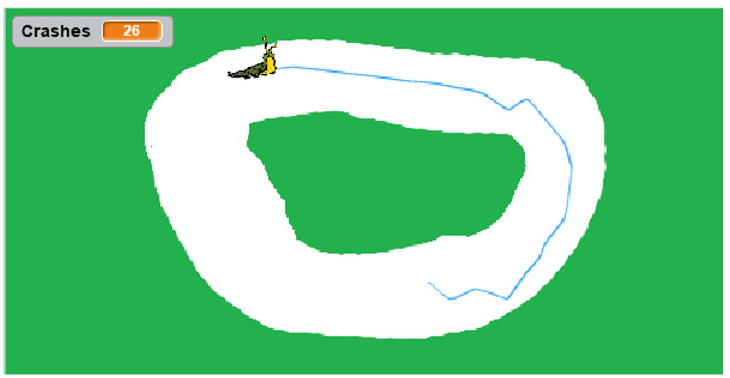
Let’s Take a Look at Slug Racer

Slide 3
New Programming Concepts
Loops
If then blocks

Slide 4
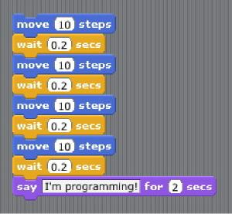
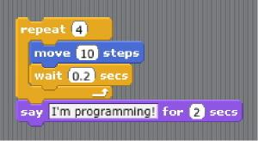
Looping (iteration)
‘Repeat’ loops
  repeat a certain number of times)
‘If-Then’ loops
  repeat until a certain condition is met (also called ‘while’ loops)
‘Forever’ loops
  These will repeat ‘forever’
  ‘Events’ are a special kind of forever loop
Scratch (and computer programming generally) has several different types of loops:

Slide 5

From Bagge, P (2012) ‘Forever Loops’ [http://code-it.co.uk/resources/foreverloops.pdf]

Slide 6
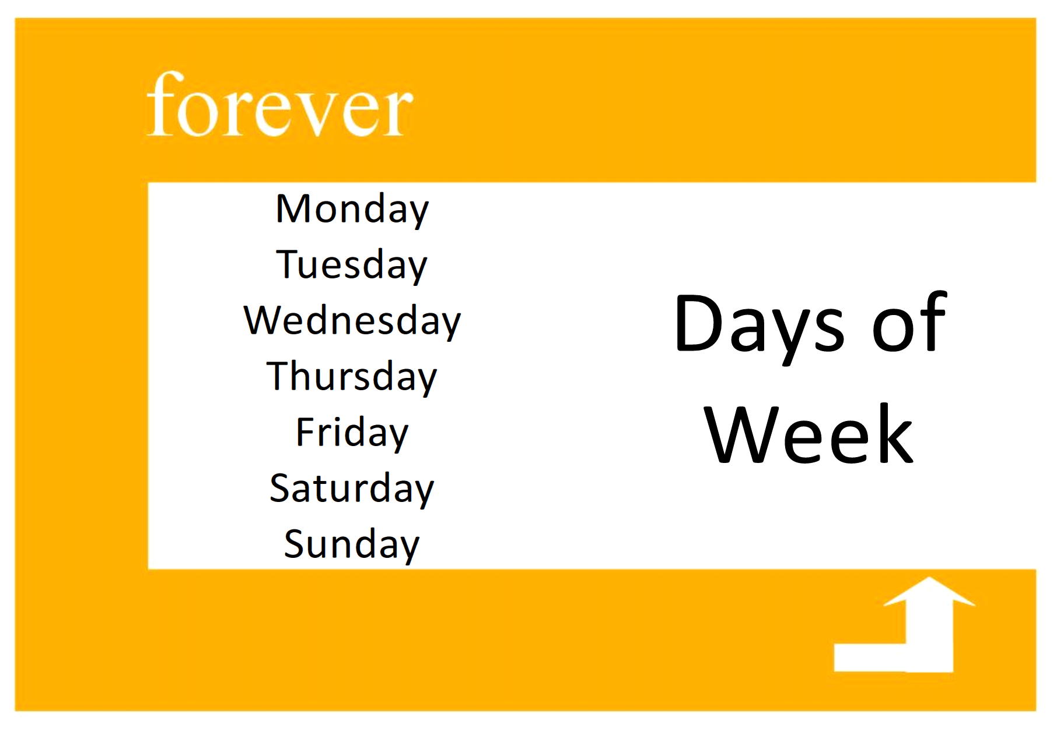
From Bagge, P (2012) ‘Forever Loops’ [http://code-it.co.uk/resources/foreverloops.pdf]

Slide 7

From Bagge, P (2012) ‘Forever Loops’ [http://code-it.co.uk/resources/foreverloops.pdf]

Slide 8


If… then… block
Example of a ‘conditional’
Gives us the ability to make decisions based on certain conditions
Allows our programs to have multiple outcomes
(Brennan & Resnick, 2012: 5)
If blocks need a ‘condition’ that is tested. If the condition is met…
…then the sequence of blocks inside this bracket gets followed
But… if the condition is not met, then the blocks inside the bracket get ignored and the computer moves on

